Slide 1
Lecture 10: Java Generics: Weaving the Universal into the Fabric of the Particular

Slide 2
Wholeness Statement
Java generics facilitate stronger type-checking, making it possible to catch potential casting errors at compile time (rather than at runtime), and in many cases eliminate the need for downcasting. Generics also make it possible to support the most general possible API for methods that can be generalized. We see this in simple methods like max and sort, and also in the new Stream methods like filter and map. Generics involve type variables that can stand for any possible type; in this sense they embody a universal quality. Yet, it is by virtue of this universal quality that we are able to specify particular types (instead of using a raw List, we can use List<T>, which allows us to specify a list of Strings – List<String> -- rather than a list of Objects, as we have to do with the raw List). This shows how the lively presence of the universal sharpens and enhances the particulars of individual expressions. Likewise, contact with the universal level of intelligence sharpens and enhances individual traits.

Slide 3
Lesson Outline
Introduction to generics
Generic methods
Wildcards
Understanding Common Generic Signatures
Generic programming with generics

Slide 4
Lesson Outline
Introduction to generics
Generic methods
Wildcards
Understanding Common Generic Signatures
Generic programming with generics

Slide 5
Introducing Generic Parameters
Prior to jdk 1.5, a collection of any type consisted of a collection of Objects, and downcasting was required to retrieve elements of the correct type.
Example:
List words = new ArrayList(); words.add(“Hello”); words.add(“ world!”); String s = ((String)words.get(0)) + ((String)words.get(1)); System.out.print(s); //output: Hello world!
In jdk 1.5, generic parameters were added to the declaration of collection classes, so that the above code could be rewritten as follows:
List<String> words = new ArrayList<String>(); words.add(“Hello”); words.add(“ world!”); String s = words.get(0) + words.get(1); System.out.print(s); //output: Hello world!

Slide 6
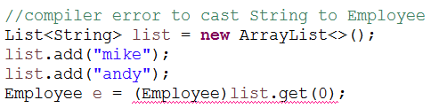
Benefits of Generics
Stronger type checks at compile time. A Java compiler applies strong type checking to generic code and issues errors if the code violates type safety. Detecting errors at compile time is always preferable to discovering them at runtime (especially since, otherwise, the problem might not show up until the software has been released).
Example of poor type-checking
List myList = new MyList(); myList.add(“Tom”); myList.add(“Bob”); // no compiler check to prevent this
Employee tom = (Employee)myList.get(0);
With Generics:

Slide 7
Elimination of casts. Downcasting is considered an “anti-pattern” in OO programming. Typically, downcasting should not be necessary (though there are some exceptions to this rule); finding the right subtype should be accomplished with late binding.
Example of bad downcasting.
ClosedCurve[] closedCurves = //…populate with Triangles //and Rectangles
if(closedCurves[0] instanceOf Triangle) print( (Triangle)closedCurve[0].area());
else
print((Rectangle)closedCurve[0].area())

Slide 8
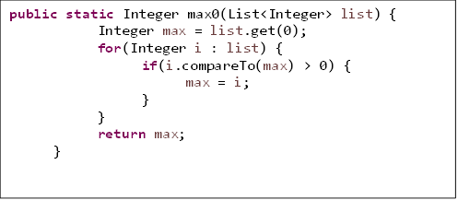
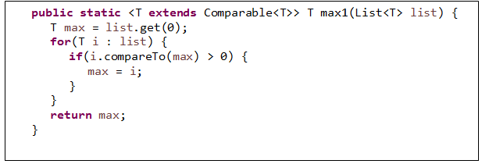
Supports the most general possible API for methods that can be generalized . Example Task: get the max element in a list (generic methods discussed in upcoming slide)

Slide 9
Generics Terminology and Naming Conventions
In the List<String> example mentioned earlier:
List<String> words = new ArrayList<String>(); words.add(“Hello”); words.add(“ world!”); String s = words.get(0) + words.get(1); System.out.print(s); //output: Hello world!
the class (found in the Java libraries) with declaration
class ArrayList<T> { . . . }
is called a generic class, and T is called a type variable or type parameter.

Slide 10

The delcaration
List<String> words;
is called a generic type invocation, String is (in this context) a type argument, and List<String> is called a parametrized type. Also, the class List, with the type argument removed, is called a raw type. Note: When raw types are used where a parametrized type is expected, the compiler issues a warning because the compile-time checks that can usually be done with parametrized types cannot be done with a raw type.

Slide 11
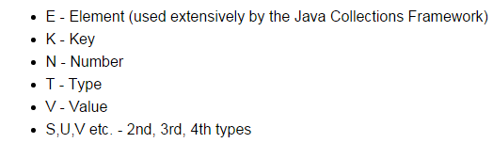
Commonly used type variables:

Slide 12
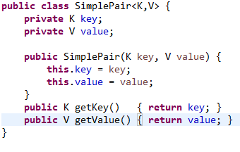
Creating Your Own Generic Class
Notes:
The class declaration introduces type variables K, V. These can then be used in the body of the class as types of variables and method arguments and return types.
The type variables may be realized as any Java object type (even user-defined), but not as a primitive type.
Usage Example:
SimplePair<String,String> pair = new
SimplePair<>(“Hello”, “World”); String hello = pair.getKey(); //hello contains the String “Hello”

Slide 13

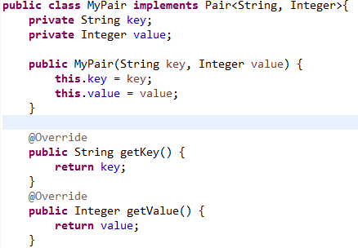
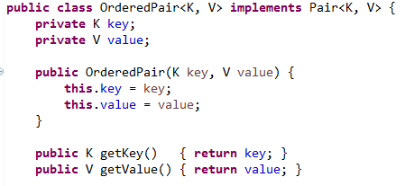
Implementing a Generic Interface
One way: Create a parametrized type implementation
Another way: Create a generic class implementation
See Demo: lesson10.lecture.generics.pairexamples
Notes:
The same points apply for extending a generic class:
Class MyList<T> extends List<T>{}
Or
Class MyList extends ArrayList<String>{}

Slide 14
Extending a Generic Class
The same points apply for extending a generic class.
Either: Create a generic class implementation
public class MyList<T> extends ArrayList<T>{
…
}
Or: Create a parametrized type implementation
public class MyList extends ArrayList<String>{
…
}

Slide 15
How Java Implements Generics: Type Erasure
The compiler transforms the following generic code
List<String> words = new ArrayList<String>(); words.add(“Hello”); words.add(“ world!”); String s = words.get(0) + words.get(1); System.out.print(s); //output: Hello world!
into the following non-generic code:
List words = new ArrayList(); words.add(“Hello”); words.add(“ world!”); String s = ((String)words.get(0)) + ((String)words.get(1)); System.out.print(s); //output: Hello world!

Slide 16
How Java Implements Generics: Type Erasure (cont.)
Java is said to implement generics by erasure because the parametrized types like List<String>, List<Integer> and List<List<Integer>> are all represented at runtime by the single type List.
Also erasure is the process of converting the first piece of code to the second
The compiled code for generics will carry out the same downcasting as was required in pre-generics Java.

Slide 17
The Downside of Java’s Implementation of Generics
Generic Subtyping Is Not Covariant. For example: ArrayList<Manager> is not a subclass of ArrayList<Employee> (this is different from arrays: Manager[] is a subclass of Employee[]: Array subtyping is covariant.)
Covariant: if they have the same subtype-supertype relationship as their type parameters.
Example: If generic subtyping were covariant, there would be unfortunate consequences:
List<Integer> ints = new ArrayList<Integer>();
ints.add(1);
ints.add(2);
List<Number> nums = ints; //compiler error
nums.add(3.14);
System.out.print(ints); //output: [1, 2, 3.14]
Notes:
Optional: (Requires strong mathematical background) The real meaning of “covariant”. A mathematical category is a collection of objects of the same type together with structure-preserving maps that map one object in the category to another. The category of sets has as its objects sets together with functions from one set to another. The collection Class of all classes (say Java classes) also forms a category; in this case, the “maps” between objects of this category are the arrows given by the subclass relation. Another category ClassArray is the collection of arrays having component type a Java class, like Employee[], Manager[], etc. Again the “maps” between these objects can be taken to be the subclass relation. The statement “array subtyping is covariant” means, technically speaking, that the transformation F: Class -> ClassArr defined by F(C) = C[ ] is functorial: If C is a subclass of D, then F(C) is a subclass of F(D). The transformation G: Class -> ParamList, given by G(C) = List<C> is not functorial according to the rules of Java generics.

Slide 18

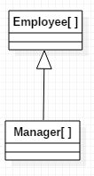

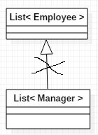
The Downside of Java’s Implementation of Generics (cont.)
not
covariant
covariant

Slide 19
The Downside of Java’s Implementation of Generics (cont.)
Component type of an array is not allowed to be a type variable. For example, we cannot create an array like this (the compiler has no information about what type of object to create) T[] arr = new T[5];
Example:
class NoGenericType {
public static <T> T[] toArray(Collection<T> coll) {
T[] arr = new T[coll.size()]; //compiler error
int k = 0; for(T element : coll) arr[k++] = element; return arr; } }

Slide 20
The Downside of Java’s Implementation of Generics (cont.)
Component type of an array is not allowed to be a parametrized type. For example: you cannot create an array like this:
List<String>[] = new List<String>[5];
Example: Anything wrong with this code?
class Another {
public static List<Integer>[] twoLists() {
List<Integer> list1 = Arrays.asList(1, 2, 3);
List<Integer> list2 = Arrays.asList(4, 5, 6);
return new List<Integer>[] {list1, list2}; } }
Notes:
[Optional] Reifiable Types
The reason for rules (2) and (3) is that the component type of an array must be a reifiable type.
Precise definition: A type is reifiable if the type is completely represented at run time
— that is, if erasure does not remove any useful information.

Slide 21
Lesson Outline
Introduction to generics
Generic methods
Wildcards
Understanding Common Generic Signatures
Generic programming with generics

Slide 22



Generic Methods
Generic methods are methods that introduce their own type parameters. This is similar to declaring a generic type, but the type parameter's scope is limited to the method where it is declared. Static and non-static generic methods are allowed, as well as generic class constructors.
The syntax for a generic method includes a type parameter, inside angle brackets, and appears right before the method's return type.
The complete syntax for invoking this method would be:
The generic type can always be inferred by the compiler, and can be left out.

Slide 23
Exercise
Write a generic method countOccurrences that counts the number of occurrences of a target object of type T in an array of type T[]. (You may assume that “equals” comparisons provide an accurate count of occurrences. You may also assume that if the target object is null, we will count the number of nulls that occur in the array.)
We start with the simple case of an array of Strings. Method signature provided below:
public static int countOccurrences(String[] arr, String target)
Now how can this method be generalized to arbitrary types?
See demo lesson10.lecture.generics.countoccurrences

Slide 24
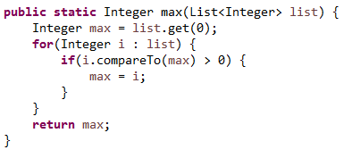
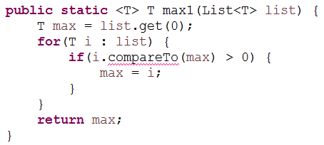
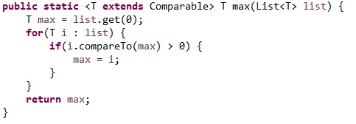
Example: Finding the max
Problem: Find the max value in a List.
Easy Case: First try finding the max of a list of Integers:
Try to generalize to an arbitrary type T (this first try doesn’t quite work…)
Problem: T may not be a type that has a compareTo operation – we get a compiler error Solution: Use the extends keyword, creating a bounded type variable
Demo: lesson10.lecture.generics.max

Slide 25
Main Point 1
Generic methods make it possible to create general-purpose methods in Java by declaring and using one or more type variables in the method. This allows a user to make use of the method using any data type that is convenient, with full compiler support for type-checking. Likewise, when individual awareness has integrated into its daily functioning the universal value of transcendental consciousness, the awareness is maximally flexible, able to flow in whatever direction is required at the moment, free of rigidity and dominance of boundaries.

Slide 26
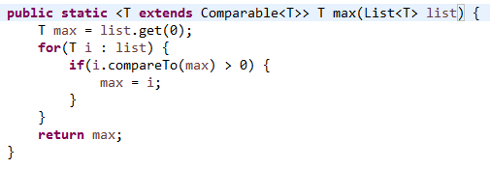
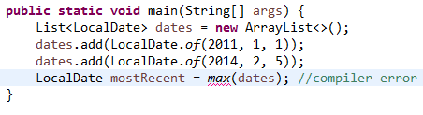
Finding the max (cont.)
The Comparable interface is also generic. For a given class C, implementing the Comparable interface implies that comparisons will be done between a current instance of C and another instance; the other instance type is the type argument to use with Comparable. For example, String implements Comparable<String>. This leads to:
This version of max can be used for most kinds of Lists, but there are exceptions. Example:

Slide 27
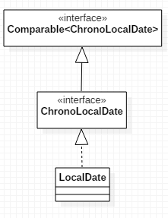
Finding the max (cont.)
The Problem: LocalDate does not implement Comparable<LocalDate>. Instead, the relationship to Comparable is the following:
What is needed is a max function that accepts types T that implement not just Comparable<T>, but even Comparable<S> for any supertype of T.
Here, T is LocalDate. We want max to accept a list of LocalDates using a Comparable<S> for any supertype of LocalDate.
The answer lies in the use of bounded wildcards.

Slide 28
Lesson Outline
Introduction to generics
Generic methods
Wildcards
Understanding Common Generic Signatures
Generic programming with generics

Slide 29
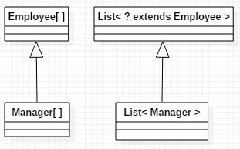
The ? extends Bounded Wildcard
The fact that generic subtyping is not covariant – as in the example that List<Manager> is not a subtype of List<Employee> – is inconvenient and unintuitive. This is remedied to a large extent with the extends bounded wildcard.

Slide 30
The ? extends Bounded Wildcard (cont.)
The ? is a wildcard and the “bound” in List<? extends Employee> is the class Employee. List<? extends Employee> is a parametrized type with a bound.
For any subclass C of Employee, List<C> is a subclass of List<? extends Employee>.
So, even though the following gives a compiler error:
List<Manager> list1 = //… populate with managers List<Employee> list2 = list1; //compiler error
the following does work:
List<Manager> list1 = //… populate with managers List<? extends Employee> list2 = list1; //compiles
(See demo lesson10.lecture.generics.extend)

Slide 31
Applications of the ? extends Wildcard
The Java Collection interface has an addAll method:
interface Collection<E> { . . . public boolean addAll(Collection<? extends E> c); . . . }
The extends wildcard in the definition makes the following possible:
List<Employee> list1 = //….populate List<Manager> list2 = //… populate list1.addAll(list2); //OK

Slide 32
Another Example Using addAll
List<Number> nums = new ArrayList<Number>();
List<Integer> ints = Arrays.asList(1, 2);
List<Double> doubles = Arrays.asList(2.78, 3.14);
nums.addAll(ints);
nums.addAll(doubles);
System.out.println(nums); //output: [1, 2, 2.78, 3.14]
Here, since Integer and Double are both subtypes of Number, it follows that List<Integer> and List<Double> are subtypes of List<? extends Number>, and addAll maybe used on nums to add elements from both ints and dbls.

Slide 33
Limitations of the extends Wildcard
When the extends wildcard is used to define a parametrized type, the type cannot be used for adding new elements.
Example:
Recall the addAll method from Collection: interface Collection<E> { . . . public boolean addAll(Collection<? extends E> c); . . . }
The following produces a compiler error:
List<Integer> ints = new ArrayList<Integer>(); ints.add(1); ints.add(2); List<? extends Number> nums = ints; nums.add(3.14); //compiler error System.out.println(ints.toString()); //if add is allowed, output? nums.add(null); //OK

Slide 34
Limitations of the extends Wildcard (cont.)
The error arises because an attempt was made to insert a value in a parametrized type with extends wildcard parameter. With the extends wildcard, values can be gotten but not inserted.
The difficulty is that adding a value to nums makes a commitment to a certain type (Double in this case), whereas nums is defined to be a List that accepts subtypes of Number, but which subtype is not determined. The value 3.14 cannot be added because it might not be the right subtype of Number.
NOTE: Although it is not possible to add to a list whose type is specified with the extends wildcard, this does not mean that such a list is read-only. It is still possible to do the following operations, available to any List: remove, removeAll, retainAll and also execute the static methods from Collections: sort, binarySearch, swap, shuffle

Slide 35
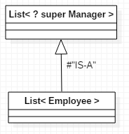
The ? super Bounded Wildcard
The type List<? super Manager> consists of objects of any supertype of the Manager class, so objects of type Employee and Object are allowed.
This diagram can be read as follows: A List<Employee> is a List whose type argument Employee is a supertype of Manager. Therefore, a List<Employee> IS-A List<? super Manager>.

Slide 36

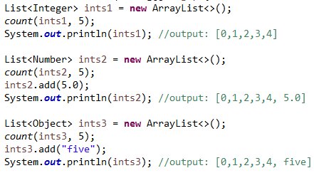
Applications of the ? super Wildcard
Example:
Since super was used, the following are legal:
The last two calls would not be legal without the use of the ? super wildcard.

Slide 37

Limitations of the super Wildcard
When the super wildcard is used to define a Collection of parametrized type, it is inconvenient to get elements from the Collection; elements can be gotten, but not typed.
Example:
However, if we try to assign a type to the return of the get method, we get a compiler error – the compiler has no way of knowing which supertype of Integer is being gotten.
Integer val = test.get(0); //compiler erro Number val = test.get(0); //compiler error Comparable val = test.get(0); //compiler error Object val = test.get(0); //OK

Slide 38
The Get and Put Principle for Bounded Wildcards
The Get and Put Principle:
Use an extends wildcard when you only get values out of a structure. Use a super wildcard when you only put values into a structure. And don’t us a wildcard at all when you both get and put values.

Slide 39
Two Exceptions to the Get and Put Rule
In a Collection that uses the extends wildcard, null can always be added legally (null is the “ultimate” subtype)
List<Integer> ints = new ArrayList<>(); ints.add(1);
ints.add(2); List<? extends Number> nums = ints; nums.add(null); //OK System.out.println(nums.toString()); //output: [1, 2, null]
In a Collection that uses the super wildcard, any object of type Object can be read legally (Object is the “ultimate” supertype).
List<? super Integer> list = new ArrayList<>(); list.add(1);
list.add(2);
Object ob = list.get(0);
System.out.println(ob.toString()); //output: 1

Slide 40
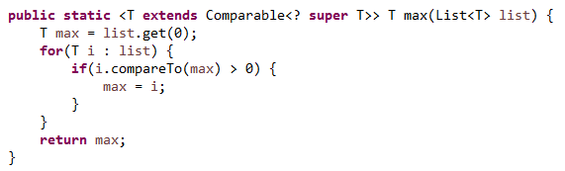
Improving max() using bounded wildcards
We saw before that the following implementation of max was not general enough
We encountered a compiler error here:
We can ensure that the type T extends Comparable<S> for any supertype of T (which, as we saw before, is what is needed here) we can use ? super
Using this version eliminates the earlier compiler error.

Slide 41
Main Point 2
The Get and Put Rule describes conditions under which a parametrized type should be used only for reading elements (when using a list is of type ? extends T), other conditions under which the parametrized type should be used only for inserting elements (when using a list of type ? super T), and still other conditions under which the parametrized type can do both (when no wildcard is used). The Get and Put principle brings to light the fundamental dynamics of existence: there is dynamism (corresponding to Put); there is silence (corresponding to Get) and there is wholeness, which unifies these two opposing natures (corresponding to Both).

Slide 42
Unbounded Wildcard
The wildcard ?, without the super or extends qualifier, is called the unbounded wildcard.
Collection<?> is an abbreviation for Collection<? extends Object>
Collection<?> is the supertype of all parametrized type Collections.

Slide 43
Lesson Outline
Introduction to generics
Generic methods
Wildcards
Understanding Common Generic Signatures
Generic programming with generics

Slide 44
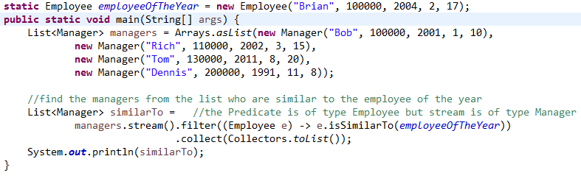
Understanding Common Generic Signatures: filter
The filter method on a Stream<T> has this signature:
Stream<T> filter(Predicate<? super T> predicate)
This means that tests that are made on the elements of the Stream can be based on relationships in a supertype of T. Here is an example:
It may be helpful in this case to write the Predicate as an inner class, to see what is going on. In this example, T is Manager (since that’s the type of the List we are starting with) and Employee is a supertype of T. (So, Predicate<Employee> IS-A Predicate<? super Manager>.)
class MyPredicate implements Predicate<Employee> { public boolean test(Employee e) { return e.isSimilarTo(employeeOfTheYear); } }

Slide 45
Understanding Common Generic Signatures: from Stream API
Stream<R> map(Function<? super T,? extends R> mapper)
Stream<T> sorted(Comparator<? super T> comparator);
void forEach(Consumer<? super T> action);
public static <T> Stream<T> concat(Stream<? extends T> a, Stream<? extends T> b)

Slide 46
Lesson Outline
Introduction to generics
Generic methods
Wildcards
Understanding Common Generic Signatures
Generic programming with generics

Slide 47
Generic Programming Using Generics
Generic programming is the technique of implementing a procedure so that it can accommodate the broadest possible range of inputs.
For instance, we have considered several implementations of a max function. The goal of generic programming in this case is to provide the most general possible max implementation.
See demo lecture.generics.max.BoundedTypeVariable for a development of examples leading to the most general possible version.

Slide 48
Connecting the Parts of Knowledge With the Wholeness of Knowledge Generic Programming Using Java’s Generic Methods
Using the raw Lists of pre-Java 1.5, one can accomplish the generic programming task of swapping two elements in an arbitrary list using the signature void swap(List, int pos1, int pos2). Using this swap method requires the programmer to recall the component types of the List, and there are no type checks by the compiler.
Using generic Lists of Java 1.5 and the technique of wildcard capture, it is possible to swap elements of an arbitrary List with compiler support for type-checking, using the following signature: <T> void swap(List<?> list, int pos1, int pos2)
Transcendental Consciousness is the universal value of the field of consciousness present at every point in creation.
Impulses Within the Transcendental Field. The presence of the transcendental level of consciousness within every point of existence makes individual expressions in the manifest field as rich, unique, and diversified as possible.
Wholeness Moving Within Itself. In Unity Consciousness, life is appreciated in the fullest possible way because the source of both unity and diversity have become a living reality.

